Slide 1


Engineering design
process
Batch-9
Title : Dust/Dirt cleaners
A.Harshith (19K41A0405)
A.Akshaya (19K41A0406)
B.Akash (19K41A0408)
N.Bhavith (19K41A0450)
Under the guidance of
Mr. Alok Govil sir
&
Mr. Rohan sir

Slide 2
Introduction
The act of making something clean by brushing or wiping the dirt/dust from any surface is called dust/dirt cleaning.
The domain we have selected is office and here are some different types of meeting rooms worth considering are large conference rooms, small meeting rooms, brainstorming rooms, video conferencing rooms, reception and greeting area, IT room, webinar and recording room etc.
The major reason we selected office as our domain is, it consists of many rooms and it is necessary to clean them regularly which is a big task for cleaning staff. So we decided to innovate and design a product to clean dust/dirt that will easily make their work done in less time and which have multiple functionalities.

Slide 3
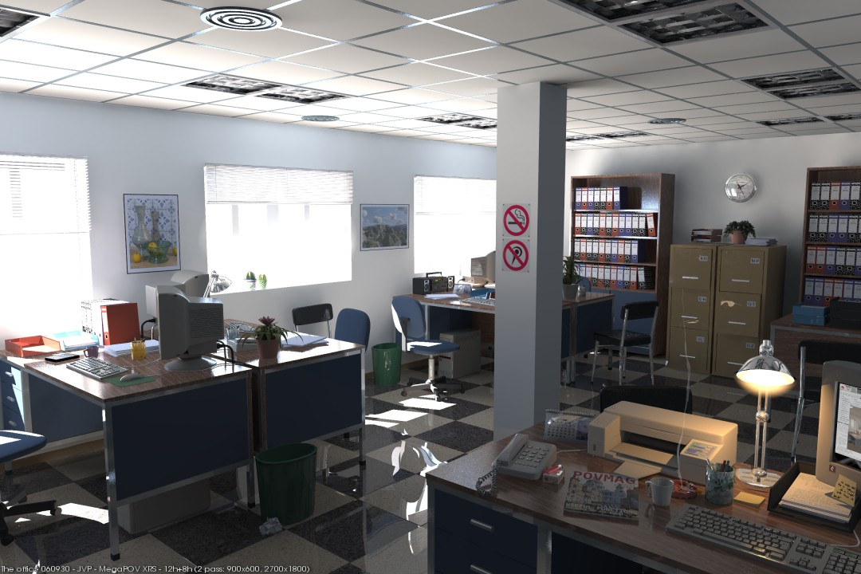
Domain/Design space
Domain : Office
We concentrate on designing dust/dirt cleaners as our product.
Easy to use and universal.

Slide 4

Users of dust cleaner at office :
Janitors
Employee’s in office
Cleaning/maintenance staff
Products used to clean dust at office :
Vacuum cleaners
Disinfecting sprays
Floor mopping cloths
Sponge mop
Broom

Slide 5
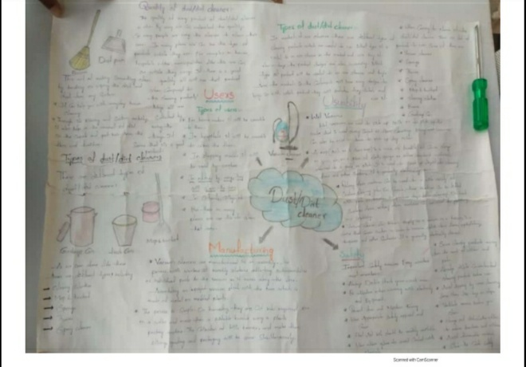
FACT SHEET

Slide 6
Problem Statement :
The janitors/cleaning staff in the office are facing problem with existing dust cleaners those are more time consuming for cleaning, if head is damaged they need to replace it with a new product, different types of cleaning products are required for cleaning at different areas, and should spend extra money for different products. So, they require multi functional dust cleaner with affordable price.
Problems found :
Wet and slippery floors.
Working at height.
Falling objects.
Obstacles (like tables, chairs and desks).
Many rooms and more time is taken to clean.
Requires many products to clean different places.

Slide 7

Need statement
The goal is to design a dust/dirt cleaner for office use, which is having multiple functionality and is time and cost effective.

Slide 8
Function structure
This is the function structure :
Dust/Dirt cleaner with multiple functionality
With 2 multiple functionality
With more than
2 multiple functionality
1st function to clean plane surfaces
2nd function is to clean surfaces at height

Slide 9
Constraints
It should be multi functional.
It should satisfy basic user needs.
It should be reliable.
It should be cost effective and value for money.
It should be user friendly.
It should be time effective and comfortable to use.

Slide 10
Order of magnitude calculations
Dimensions / Sizing :
(These are the dimensions of selected concept)
(FOR HANDLE)
Height = 5ft, Inner radius = 2cm, outer radius = 2.5cm, Inner threading height = 4cm
(FOR HEAD)
Length = 25cm and 10cm, width = 15cm, thickness = 5mm (surfaces at height)
Inner radius = 9.5cm, outer radius = 10cm, height = 2cm (floor)
Inner radius = 1.5cm, outer radius = 1.9 cm, outer threading height = 4cm
Weight of product is = weight of handle + weight of head part
(approx. 400 to 500gr) (approx. 100 to 200gr)
The total weight should be around 500 to 600 grams.

Slide 11
Market :
The major customers of our product are cleaning/maintenance staff at offices.
There are thousands of offices overall in India. They need dust/dirt cleaners to clean. So, it makes a very big market to sell the product.
The product we design is approximately 150 rupees (includes cost of raw material, taxes, manufacturing cost).
Compared to other products, the product we design is much lesser cost, multifunctional.
Which makes our product more reliable to purchase compared to others.
Value :
The product we design have multiple functionalities and is cost and time effective.
It saves the time and effort of our customer, because it is multifunctional, so customer can use it for multiple cleaning tasks without using the other one.
As we mentioned in function structure its functionality is to clean at plane and surfaces at height, so the customer doesn’t require multiple products to clean, they can use this single product we made for both needs with comfort.

Slide 12
Design requirements
Performance :
Easy to move while cleaning dust.
It should be multi functional.
Value :
It should approximately cost rupees 150 to 250.
Safety :
To make sure there are no sharp edges and grip for
handle should be good.

Slide 13
Concept generation using Morphology Matrix
Material used for head : | Plastic with cloth | Plastic with sponge | Specific
Materials used for handle : | Wood | Metal | Plastic
Shape of head : | Circular | Square | Specific
Shape of handle : | Hollow cylinder | Solid cylinder
Height : | 3 feet | 4 feet | Specific
Extra feature : | Head replaceable | Body transparent | Height adjustable

Slide 14
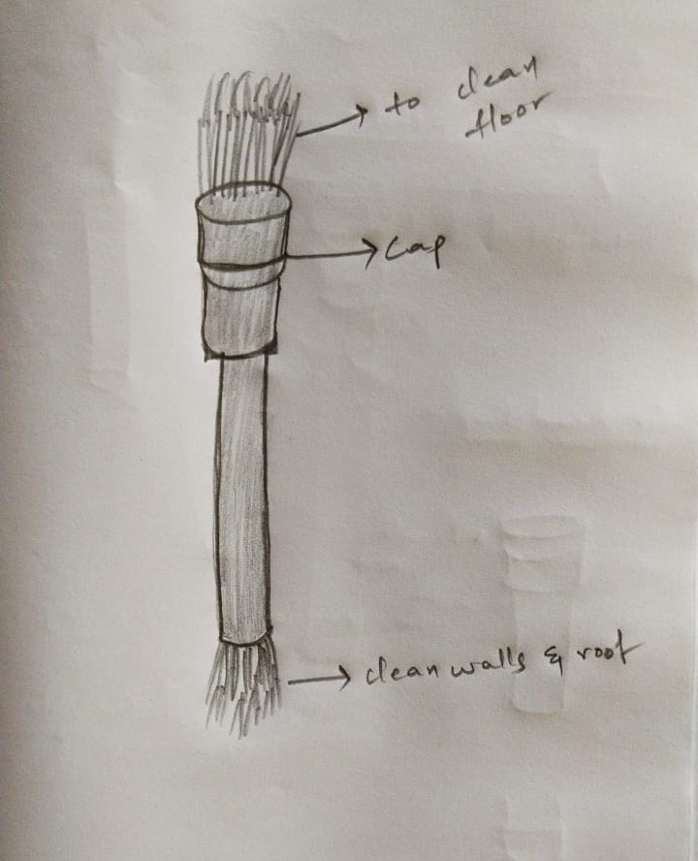
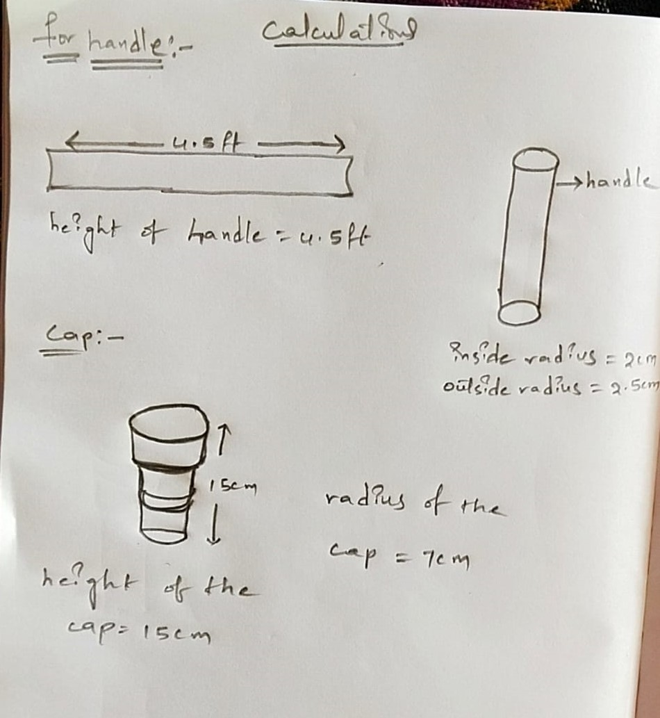
Concept-1(Sketches and CAD Model) by 405

Slide 15
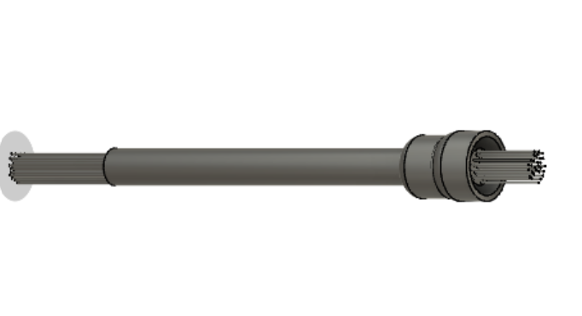
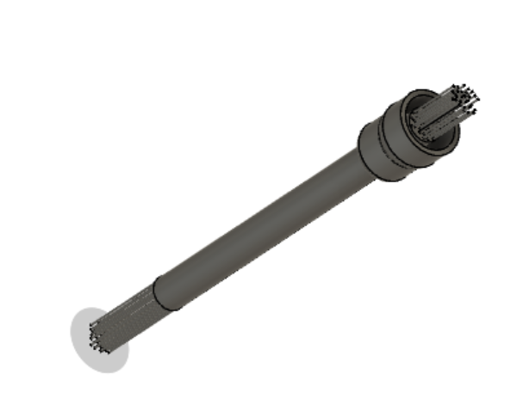

Slide 16
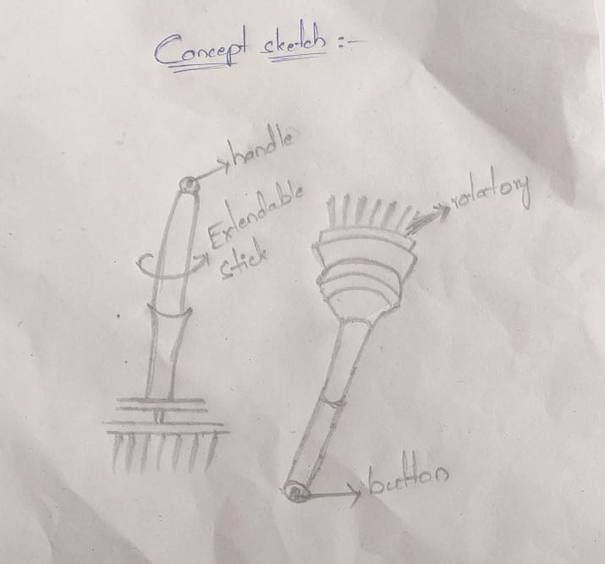
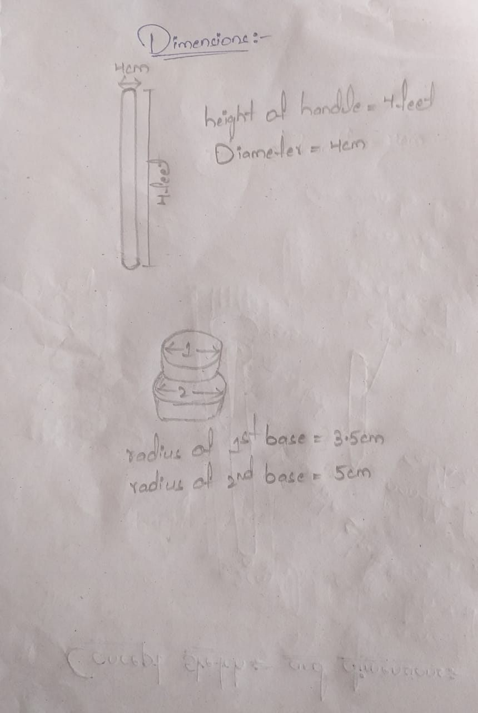
Concept-2(Sketches and CAD Model) by 406

Slide 17
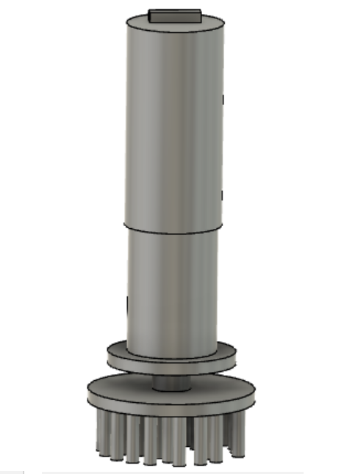
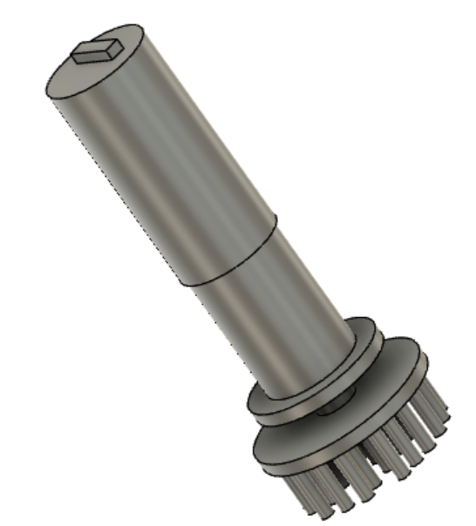

Slide 18
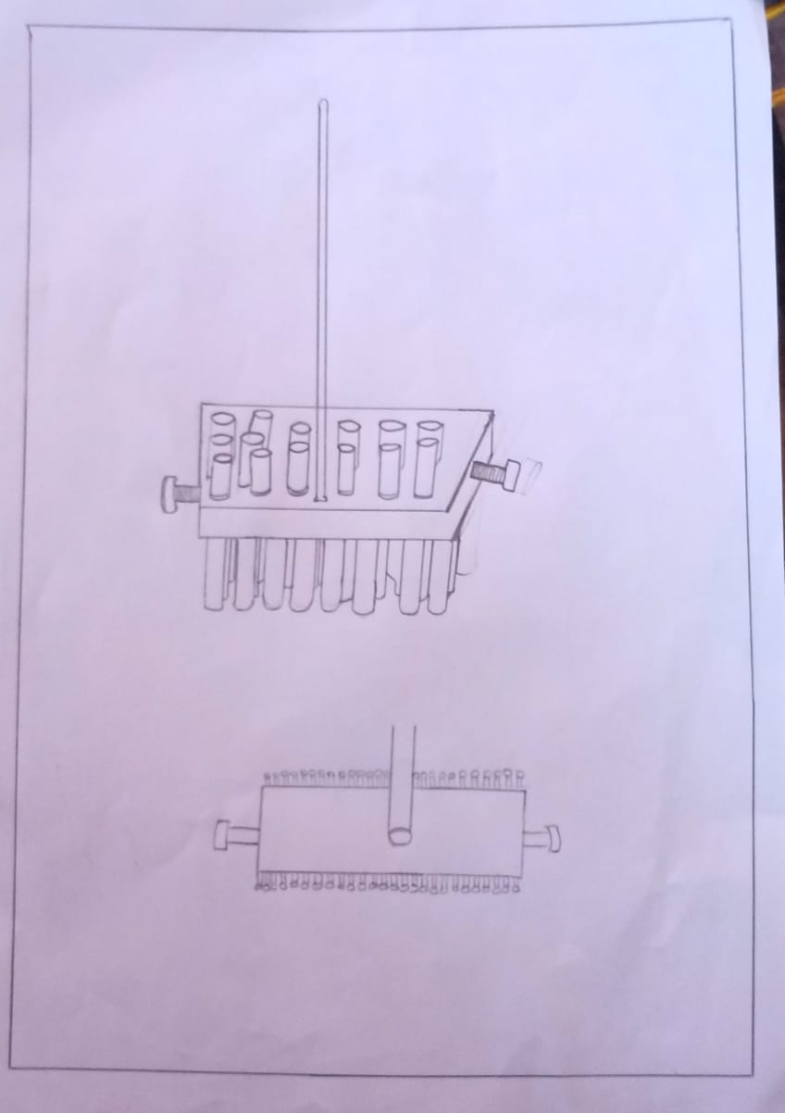
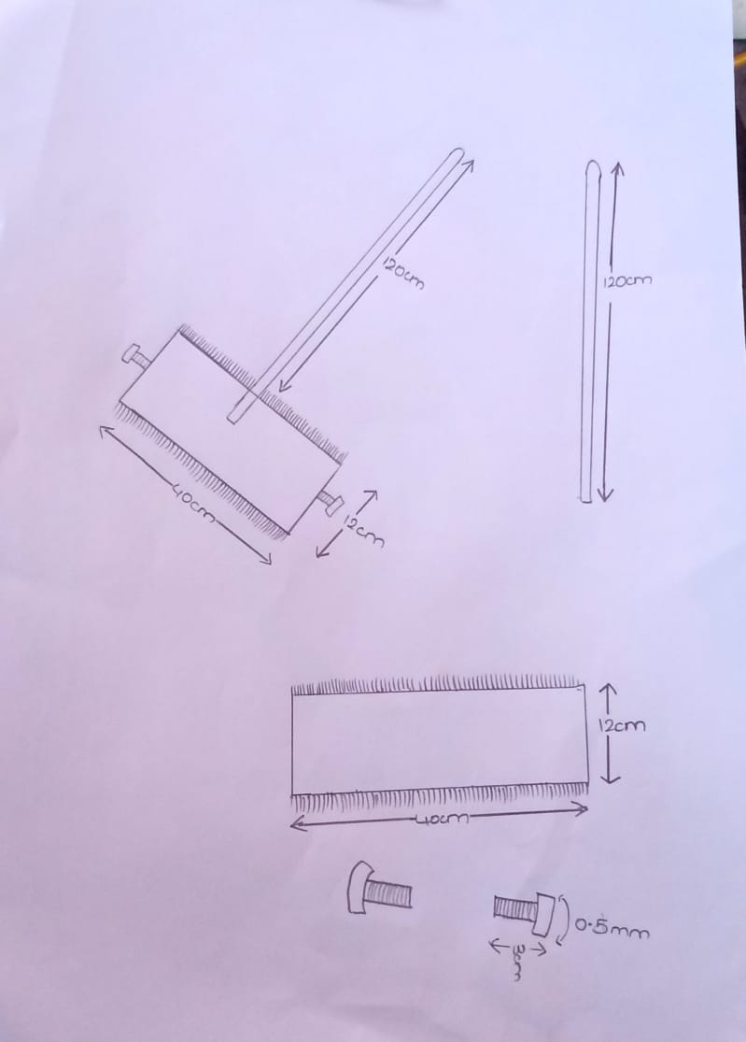
Concept-3(Sketches and CAD Model) by 408

Slide 19
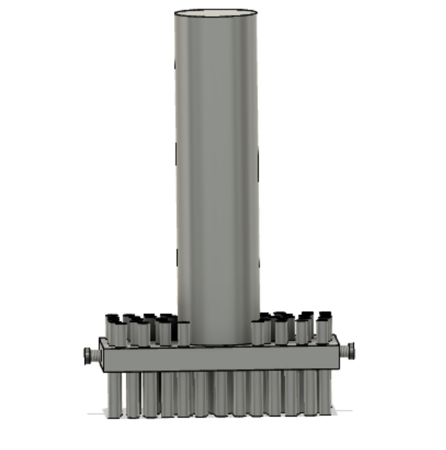
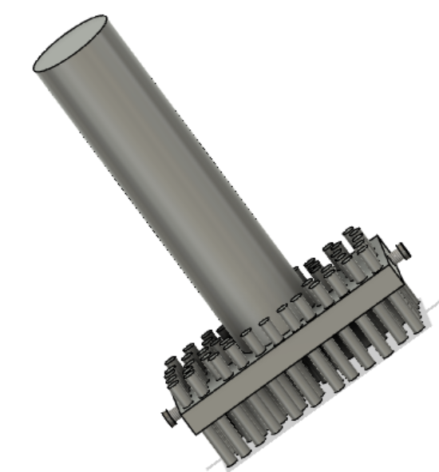
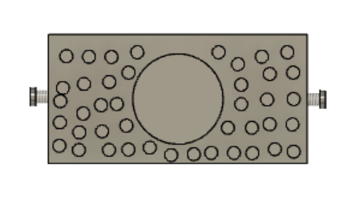

Slide 20
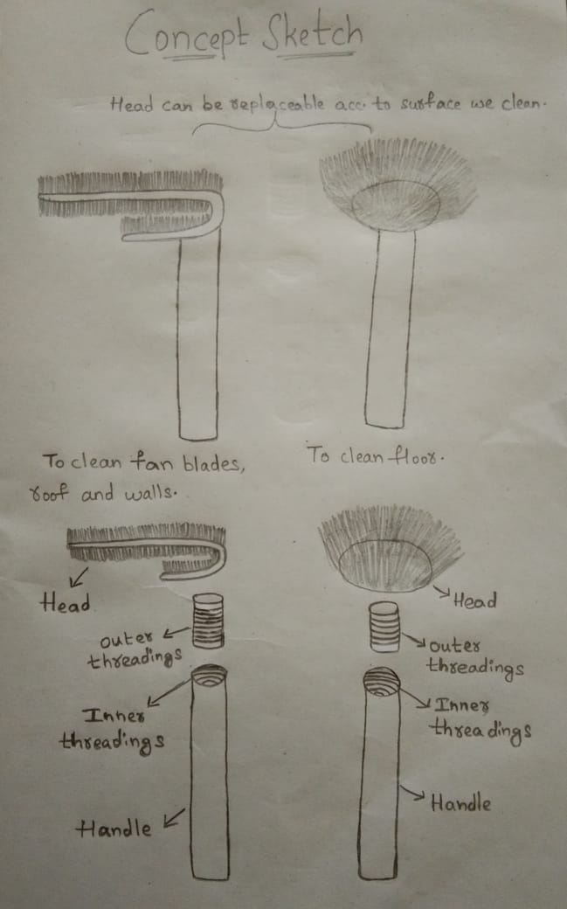
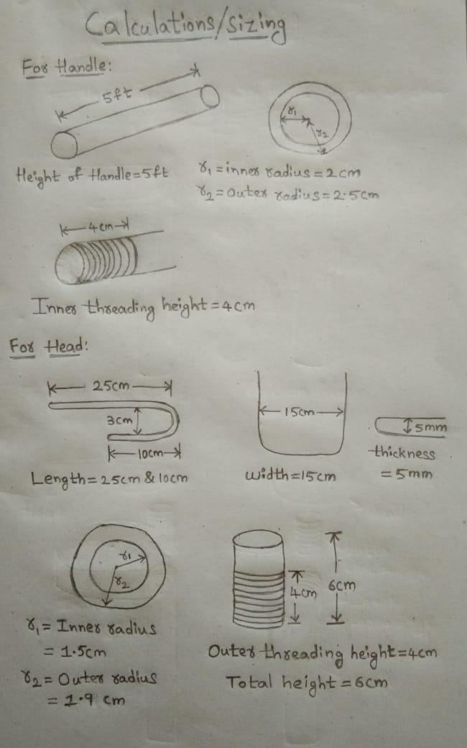
Concept-4(Sketches and CAD Model) by 450

Slide 21
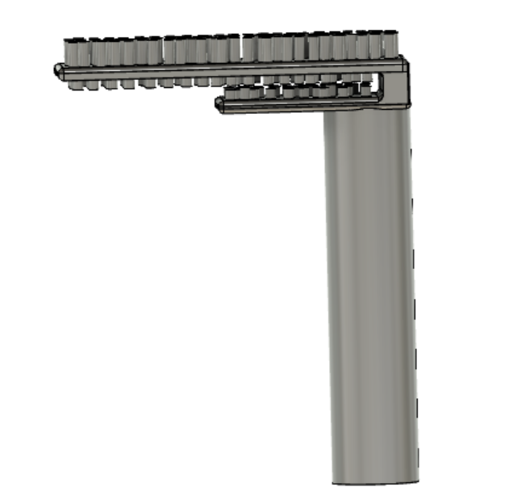
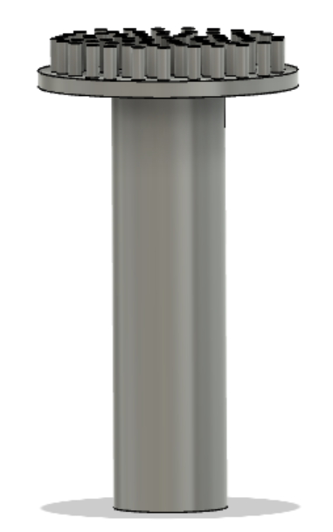
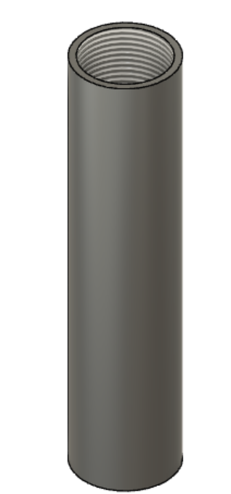

Slide 22
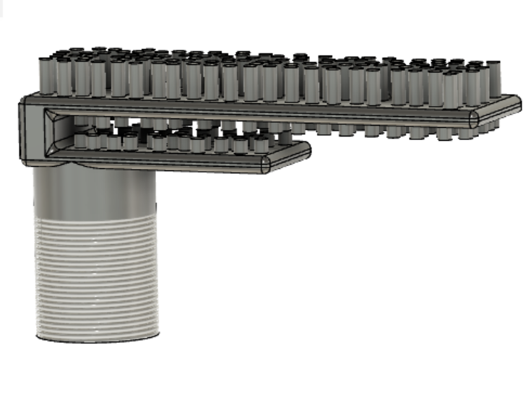
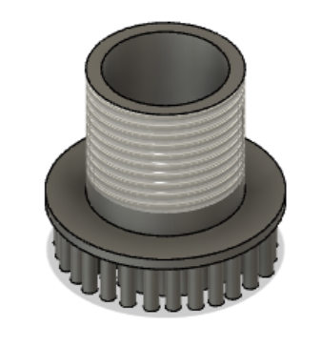
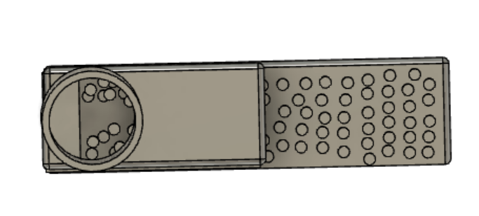

Slide 23
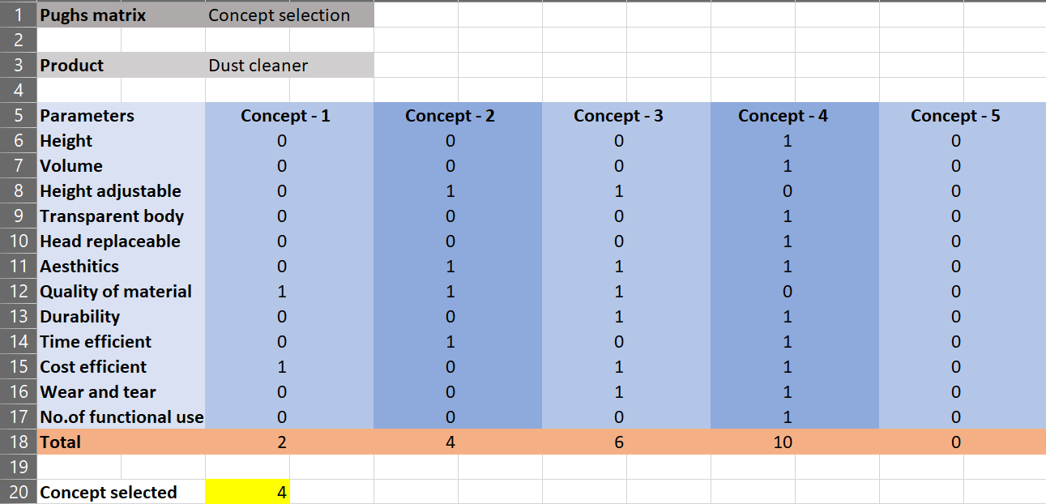
Concept selection – Pugh’s matrix

Slide 24
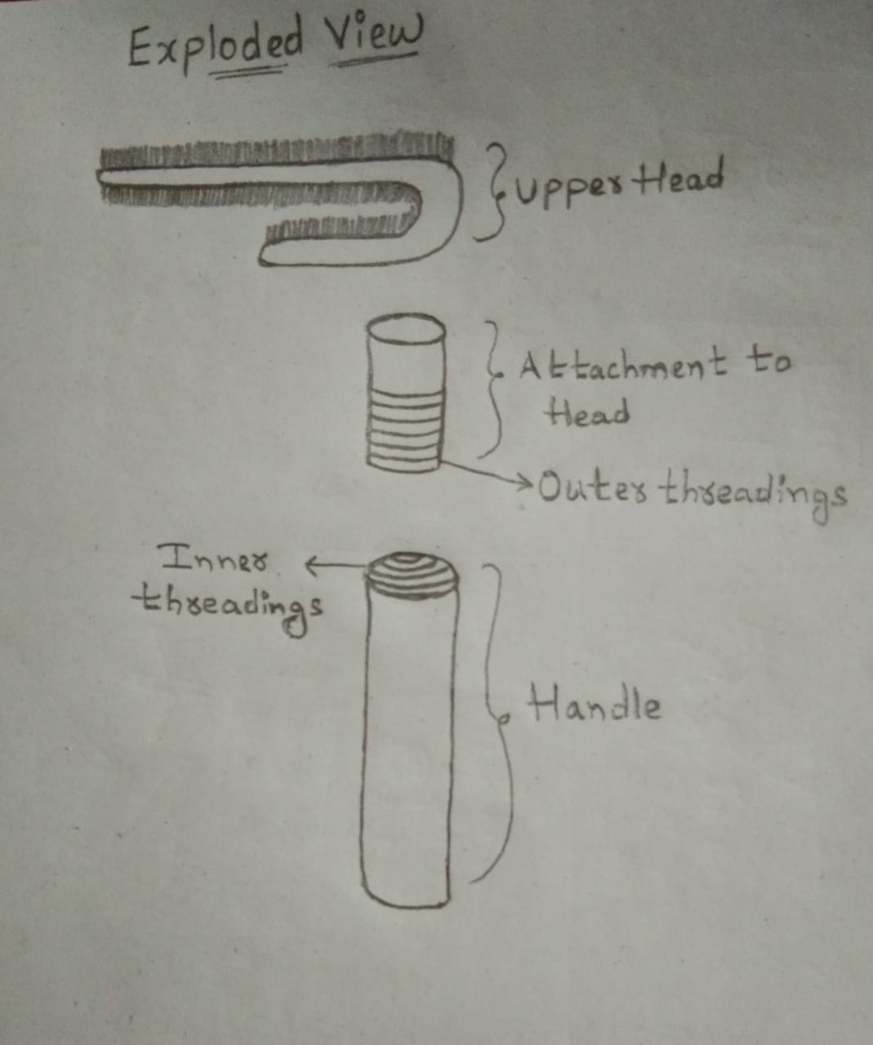
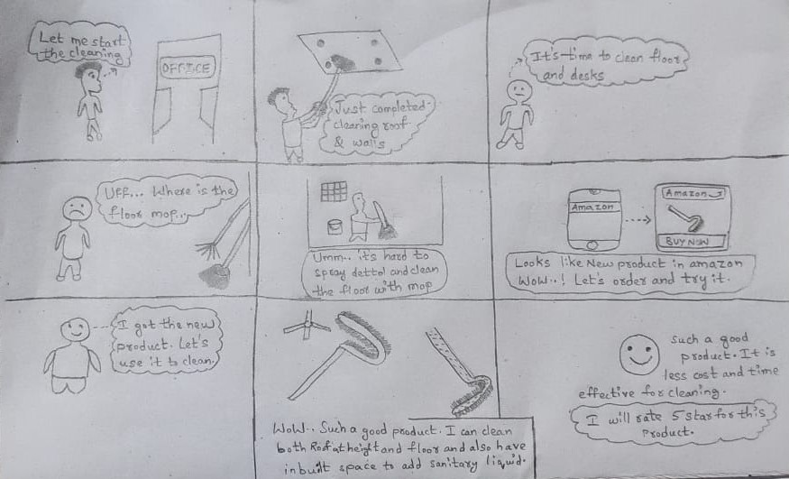
Selected concept sketches – Exploded view and story board

Slide 25
CAD Model – High quality render

Slide 26
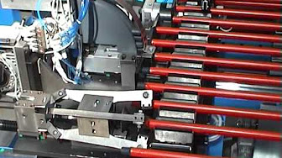
Manufacturing process – Tools and Techniques
For manufacturing of our product we require raw material plastic further it is molded into the required shape. For head part plastic is molded to c shape with hollow cylinder at bottom and threading on outer side. For handle plastic should be molded into open top Cylinder with threading at inner side. Then yarn is attached to c shaped head part.
Cutting, molding, folding, measuring are some techniques used while manufacturing.

Slide 27
Cost Estimate
Cost of raw materials :
Cost of transparent PET plastic : 30 rupees
Cost of yarn : 20 rupees
Cost of manufacturing : 50 rupees
Taxes : 18 rupees
Miscellaneous costs : 30 rupees
Final cost estimation approximately : 150 rupees

Slide 28
Future Scope
To overcome problems of regular dust cleaners we made a dust cleaner with multiple functionalities such that it can clean high roof, fans, floor, window glasses, office desks etc.
It also have features like replaceable head, transparent body.
All these extra features are packed for a minimal price.
So, there are higher chances for our product to succeed in outside market.

Slide 29
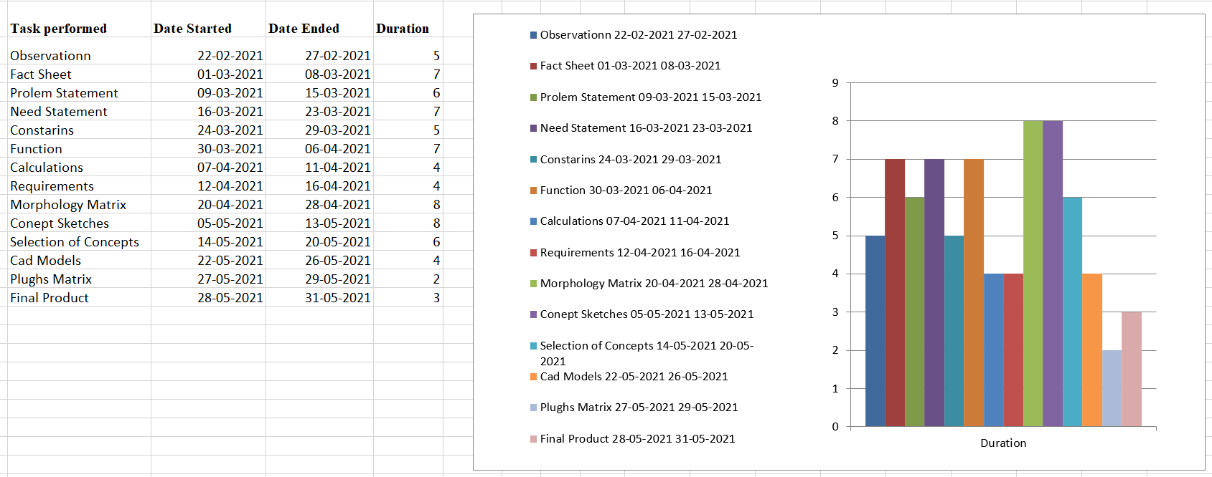
GANTT chart

Slide 30
Patent search
Multi-purpose mop apparatus and method of use :
Application no. : 13766360
Application date : 13.02.2013
Applicants : Minh T. Dinh Inventors : Minh T. Dinh
Abstract :A multi-purpose mop apparatus includes a mop having a mop handle and a cleaning attachment removably mounted thereon, the mop handle further comprising a base and a grip installed thereon for manipulating the mop during use. The cleaning attachment may be a mop material cinched onto the base of the mop handle using a drawstring or may be a squeegee strapped thereto. A removable extension handle may be pivotally installed on the mop handle and configured for use in multiple configurations and modes.

Slide 31
CLEANING TOOL WITH REMOVABLE CLEANING SHEETS :
Publication Number : WO/1999/063879
Publication Date : 16.12.1999
Applicants : McKAY, William, D. [US]/[US]
Inventors : McKAY, William, D.
Abstract : A mop (10) for cleaning a floor includes a handle (12) for a user to grip the mop (10) and a mop head (20) which is interconnected with the handle (12). The mop head (20) has a lower surface (24) and an upper surface (22), each of which have a side to side width and a back to front length. Multiple cleaning sheets (46) are each removably supported on the lower surface (22) in a stacked configuration. Each of the sheets (46) has an outerward face (60) for cleaning and an opposed inward face (62). The outward face (60) of each of the sheets (46) is configured for contacting and cleaning the floor causing them to be soiled. When the outward face (60) of the outermost sheet becomes soiled, that sheet may be peeled away to expose a non-soiled sheet. In some embodiments, the mop head (20) and the handle (12) are pivotally interconnected.

Slide 32
References
https://patentscope.wipo.int
www.knowyourgst.com
https://m.indianmart.com
Amazon.com
Flipkart.com
https://www.businessinsider.com
https://home.howstuffworks.com

Slide 33
Thank you…

